Slide 1
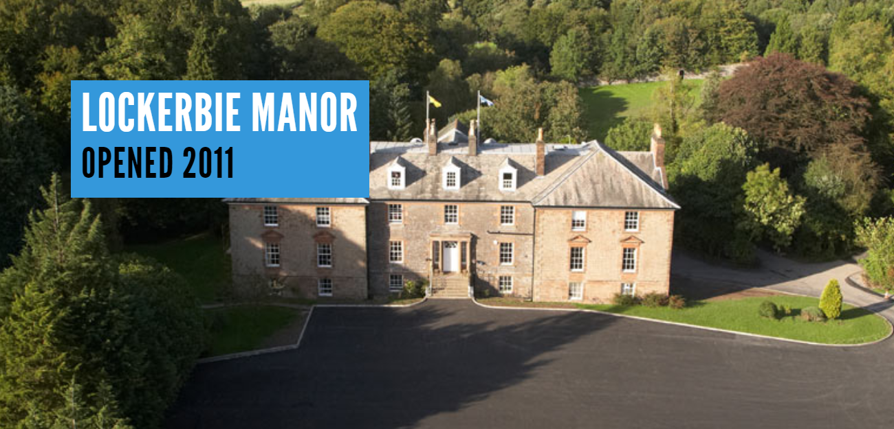

Slide 3
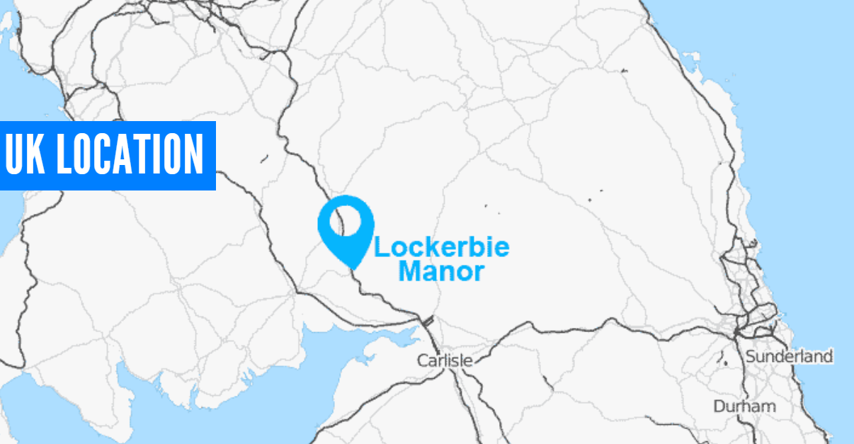

Slide 6
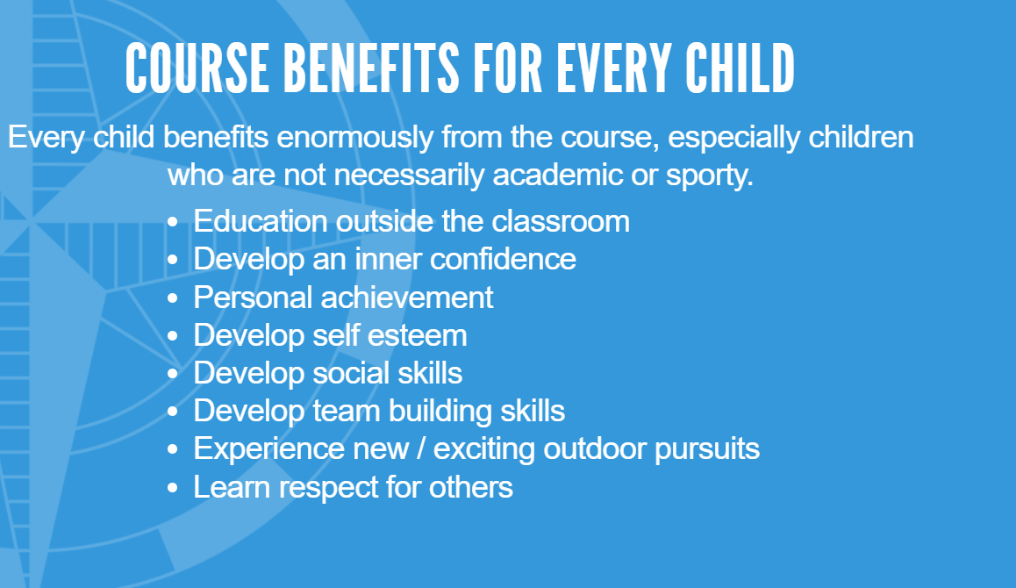

Slide 7
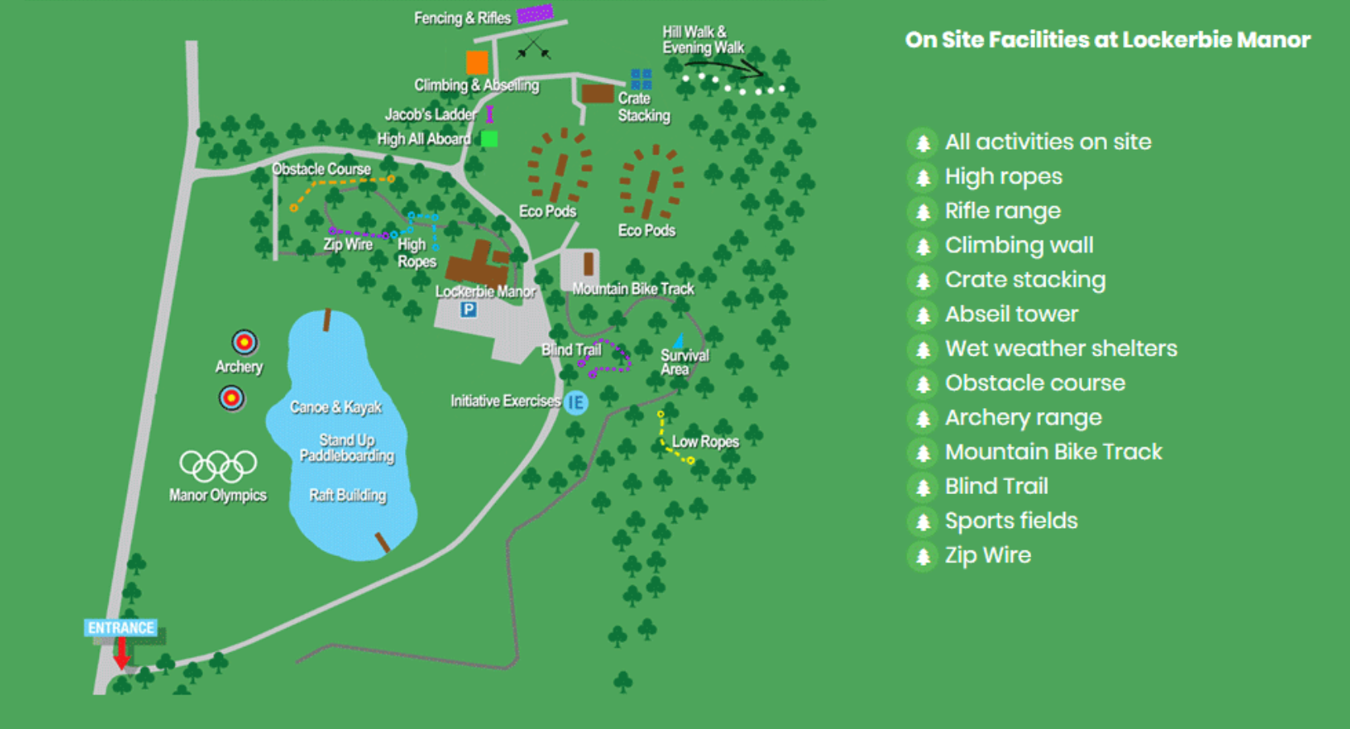

Slide 8
All activities are lead by fully trained and experienced staff at Lockerbie Manor.
Please arrive dressed for the first activity (not water-based).
Children may bring a hand luggage bag for the journey.

Slide 9
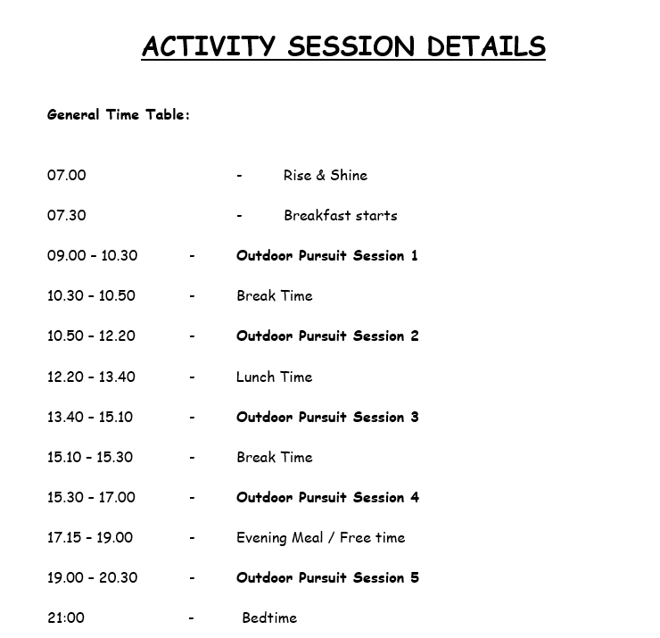

Slide 10
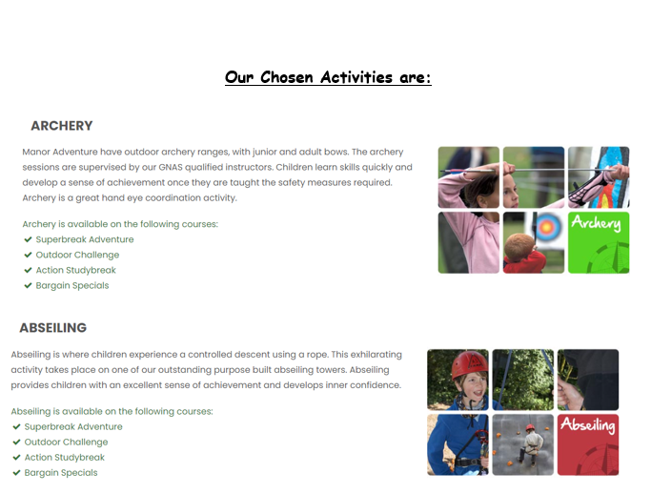

Slide 11
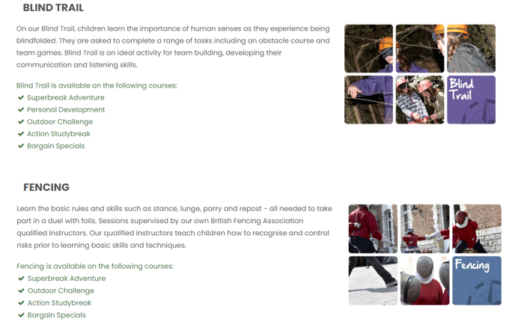

Slide 12
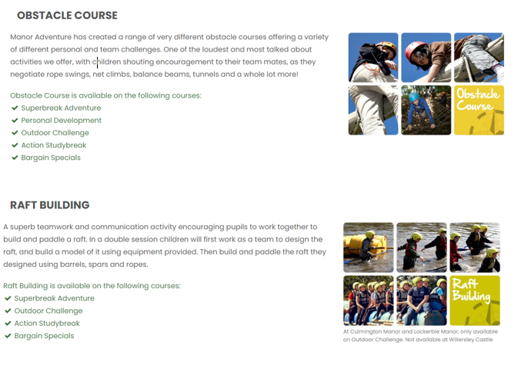

Slide 13
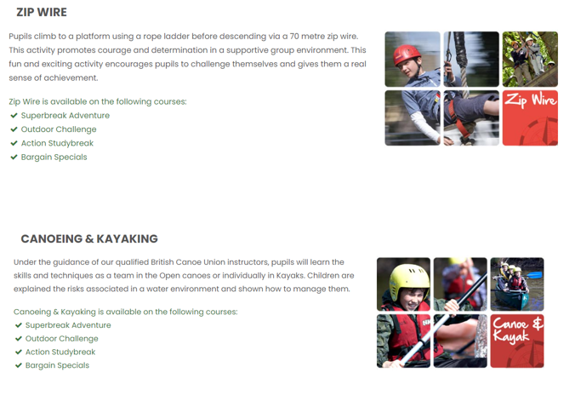

Slide 14
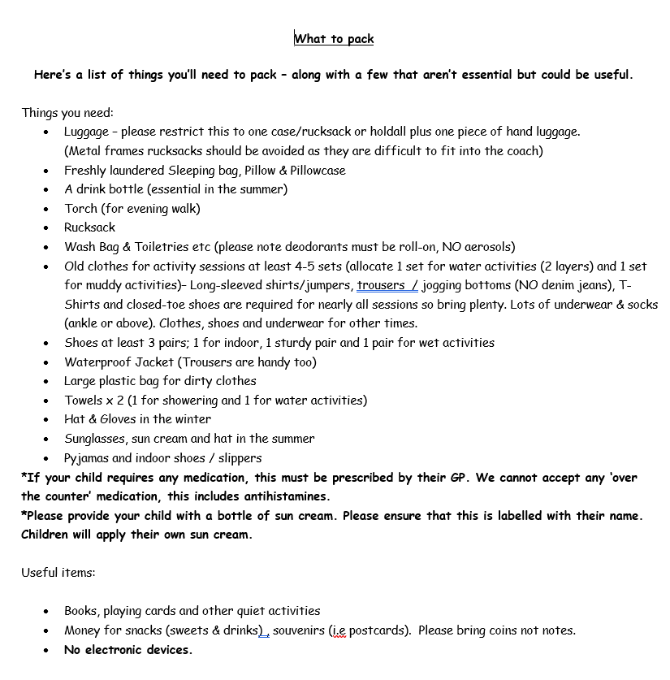
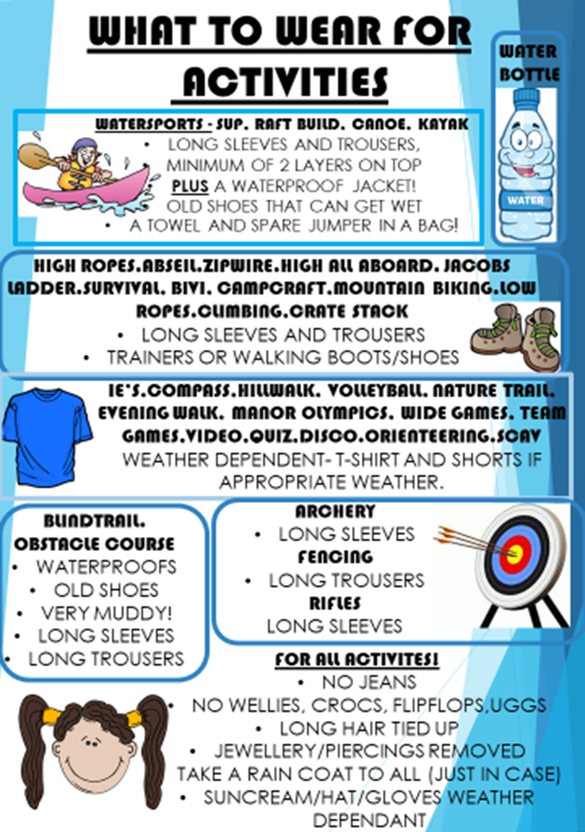

Slide 15
Key points for packing:
Please pack with your child so that they know what is in their bag. Make sure they can carry it too.
Remember- one case and one hand luggage only
Ensure plenty of clothing is packed and at least 3 pairs of shoes.
2 towels must be brought.
Ensure only roll-on deodorants are packed.
Don’t forget sleeping bags, pillow and pillow cases.
Please provide your children with water bottles.
No electronics! We will post photographs on our Facebook page so that you can all the fun we’re having.

Slide 16
Medical Needs:
Please keep us up to date of any medication that your child is taking.
All medication (except inhalers) will be administered by a member of school staff.
Only prescribed medication is allowed. This includes antihistamines.
Please provide your child with a labelled bottle of sun cream. Children will apply their own sun cream.
First aid kit will be carried and will also be on site.
All staff are first aid trained.

Slide 17
All dietary requirements have been passed onto Lockerbie Manor staff and we will ensure that these are met.
Please let us know of any dietary requirements that we may not already be aware of.
We will be requesting the menu in advance so that we can ensure dietary needs are met.

Slide 19
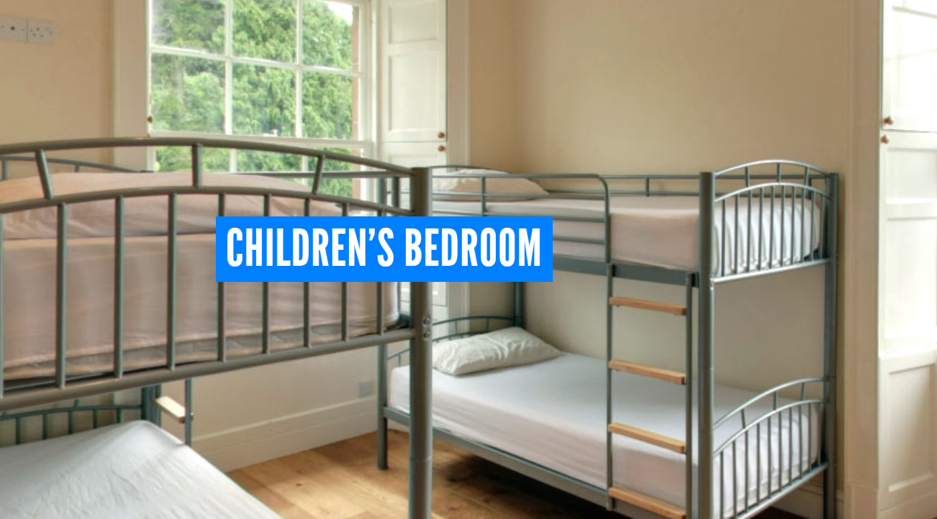
Room Allocations:
Due to Covid, and the fact that the schools have not mixed as much this year, we will be keeping the children in rooms with their own classmates.
Children will be in rooms with those of the same gender.
Staff will consider friendship groups when allocating rooms, however we cannot guarantee that entire friendship groups will room together.
We will ask the children who they would like to share with and we try to accommodate this. Again, we cannot make any guarantees.
Adults room are within the vicinity of the children’s rooms.

Slide 21
Any questions?

