Slide 1
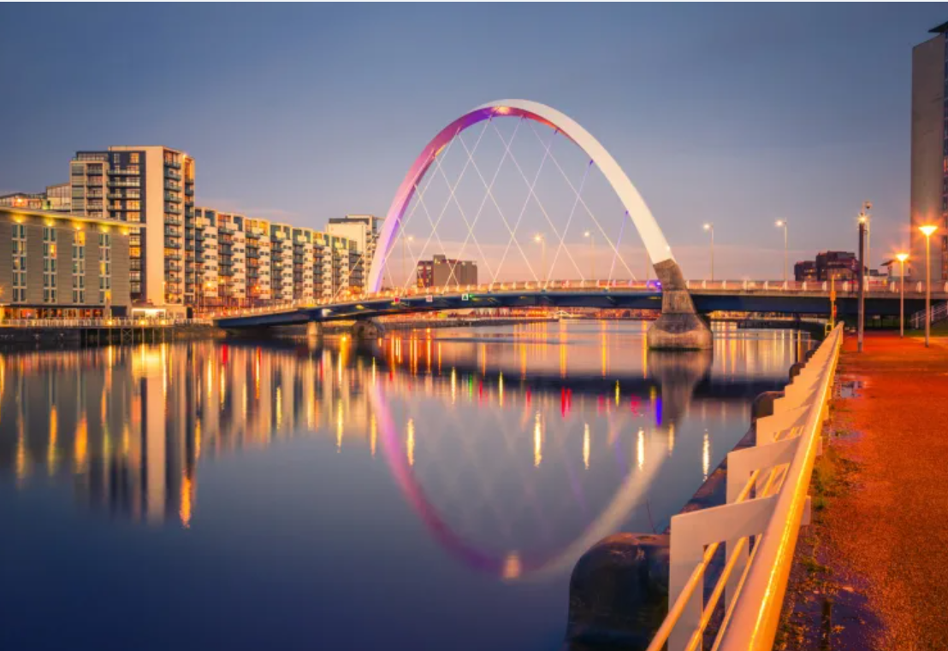
Welcome to Clyde Class

Slide 2
Who will be working in Clyde Class?
Mrs Makepeace
Ms Eames
Mrs Hosking.

Slide 3
Expectations:
No earrings or jewellery to be worn in school including nail varnish.
Keep toys at home.
School shoes or black trainers only for school (no bright trainers).

Slide 4
Behaviour Expectations:
Traffic Light system.
Start the day on green (unless they have moved up they stay on that colour).
If they move down to yellow, orange or red they will start the next day on green.
If your child is on red they will complete a behaviour reflection form which will go home with them.

Slide 5
What does my child need to bring school?
Everyday they must bring their water bottle (with water or diluted juice), jacket/ coat, home/school diary and their reading book, slippers.
Wellies: for the colder and wetter months for playtimes in the woodland area.

Slide 6
What homework will my child be getting this year?
Reading every night.
Weekly spellings: they will get their spelling list on a Monday and the test will be the following Monday.
Year 2 EdShed.
Topic homework every half term.

Slide 7
How often will my child have a new reading book?
New reading books will go home on a Thursday.
One new reading book per week.
If reading books are not in school their new reading book will stay in school until the old one is returned.
Library day will be Friday, again your child can get a new library book if they return the book they have had at home.

Slide 8
What day will PE be on?
PE will be on Tuesdays and Wednesdays.
Children to come to school in their PE kit.
PE Kit consists of: white t-shirt, black shorts or trousers, green hoodie or jumper and trainers.

Slide 9
If you need to contact Mrs. Makepeace, you can use the office email address or our class email which is:
clyde@westtynefederation.uk

