Slide 1
Eden Class
Welcome to Reception

Slide 2
Useful Information
Class Teachers | Teaching Assistants | PE | Forest School | Book Bags
Miss Thompson (Monday – Thursday) Mrs Mitchell (Friday) | Mrs Brachtvogel (Mrs B) Miss Eames Mrs Hoskyns | Tuesday (with nursery) Commando Joes Thursday (Reception only) Speed, agility and travel Children are to come to school dressed in their PE kit. | Friday Please can long trousers or leggings be worn to protects from nettle stings, thorns and insect bites. | Please send in every day: - drink bottle - school diary - class reading book

Slide 3
“Play is the highest form of research.”
Albert Einstein
Play is not just about having fun but about taking risks, experimenting, and testing boundaries.

Slide 4
School Website
Greenhead C of E Primary School – Home
Our School website contains lots of useful information and support for our parents and carers:
Lunch menu
Term dates
Meet the staff
Long term planning and curriculum grids
Links to parent portal for Little Wandle Letters and Sounds Revised Phonics
Newsletters
Policies

Slide 6
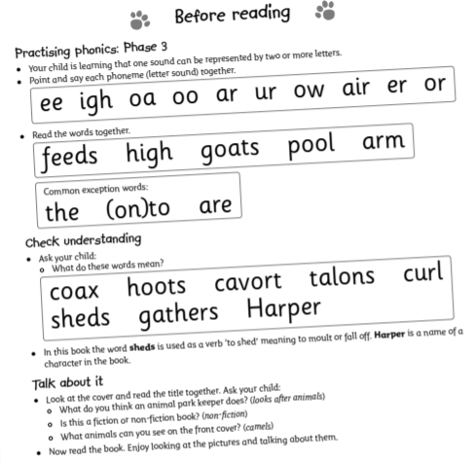
Class Reading book
We begin with wordless books which develop great language skills and teach children the layout of books and how to handle books.
Once children have a secure knowledge of a number
of GPC’s (Grapheme Phoneme Correspondences) and are confidently blending, they will be ready for reading books.
Children will take their Reading Book
Home to read to read with you, please make sure
they are returned everyday in book bags as we
need them for our reading sessions.
Share the front cover page before reading – this cover sounds and words contained in the book.
Celebrate, praise, talk about the book with you child.
Please look after our books.
Supporting at home.
Reading for pleasure books
Children will also bring home a ‘reading for pleasure book’ from our class library each week. Children will change their Library book on a Friday.
To become lifelong readers, it is essential that they read for pleasure.
Children may not be able to read this book independently, but these books offer a wealth of opportunities for talking about the pictures and enjoying the story or information text.
Enjoy the book together and
foster a love of reading.

Slide 7
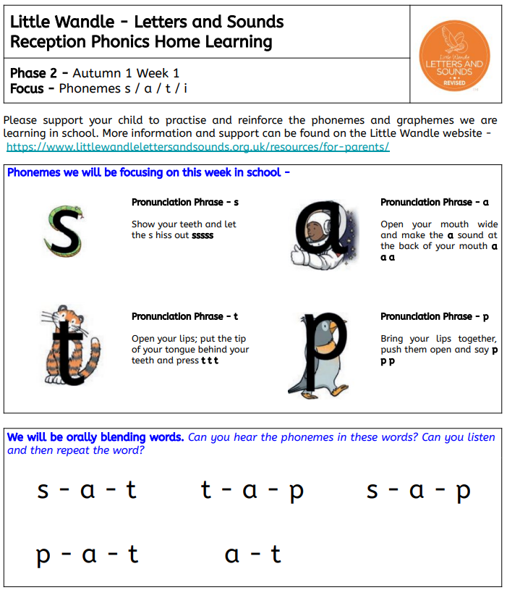
School Diary
Please write in your child’s diary when you have read with them. The diary needs to be sent into school every day.
We will also send home a phonics sound practice sheet to keep you up to date with your child’s learning and to help support them at home. Please explore the Little Wandle Parent Page, the pronunciation videos are very short and demonstrate the correct way to pronounce the sounds.

Slide 8
Questions?
Thank you for attending this afternoon.
Please don’t be a stranger! We have a class e-mail which is checked daily: eden@westtynefederation.uk
You can contact the school office on:
01697 747347
greenhead@westtynefederation.uk

